Slide 1
PARALLEL, DISTRIBUTED, AND HIGH-PERFORMANCE COMPUTING (HPC)
Topic: Leveraging High-Performance Computing for
Enhanced Hate Speech and Offensive Language Detection on Twitter
Group Members:
Saiyeda Sabiha (23241133)
Mourika Nigar Mouny (20241004)
Sheikh Yasir Hossain (20301013)
Tahiatun Nazi (20301008)
Group No: 36
Instructor: Annajiat Alim Rasel
ST: Farah Binta Haque
RA: Md Humayun Kabir Mehedi

Slide 2
Abstract:
Addressing the urgent problem of offensive language on social media platforms, with a focus on Twitter.
Targeting evolving computing power needs, especially for Artificial Intelligence applications in High-Performance Computing (HPC).
Used ML algorithms models such as NB Classifier, KNN, Decision Trees, and LR to detect hate speech and offensive language.
Research aims to further advance the field of automated offensive language detection by building upon these foundations.

Slide 3
Introduction:
The paper delves into the dynamic world of social media, emphasizing the transformative impact of hate speech identification.
Beyond hate speech, the combination of HPC and machine learning is described as an irreversible force that raises the bar for computational power.
The research expands its scope to include low-resource languages like Marathi, addressing the effects of offensive content and cyberbullying on mental health.
Based on the ML algorithm models, LR shows high accuracy.

Slide 4
Literature review:
Machine learning and HPC reshape computational power and research applications.
Ensemble techniques and classic classifiers, particularly Decision Trees and Stochastic Gradient Boosting, are widely effective for hate speech detection.
Machine learning and HPC convergence influence diverse domains like finance, medical diagnosis, and scientific simulations.
Detecting offensive language in low-resource languages like Marathi is significant, utilizing pre-trained BERT models and data augmentation.
Machine learning tackles challenges in unique language formats on Twitter, with Naive Bayes surpassing Linear SVM.
Convolutional neural networks and inception modules classify bone cancer stages with high accuracy, showcasing module advantages.
BERT proves effective in advanced deep learning models for hate speech classification.
Support vector machines achieve high accuracy in classifying tweets and introduce a module for filtering hateful and offensive content.

Slide 5
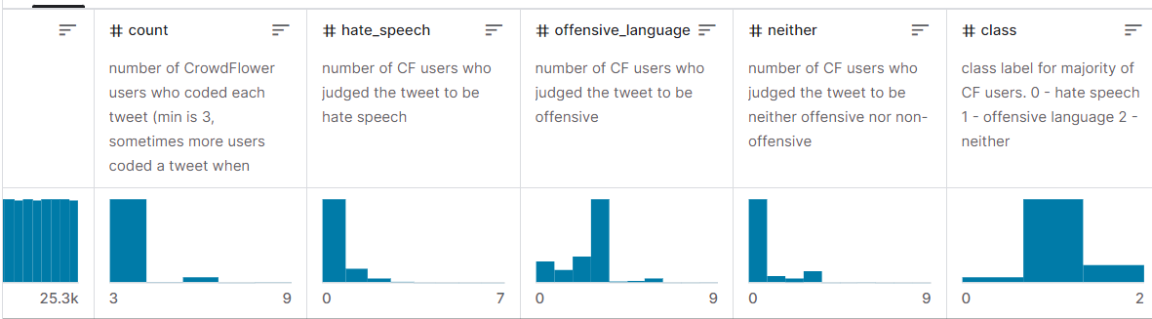
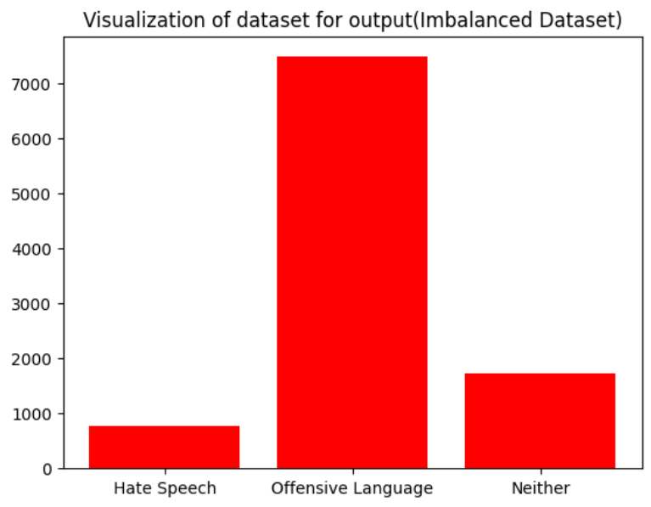
Data Type
Dataset Preprocessing
1. Removal of Punctuations
2. Lower casing
3. Tokenization
4. Removal of Stop Words
5. Lemmatization

Slide 6
Methodology:
Apply KNN, Logistic Regression, Naive Bayes, and Decision Tree independently for hate speech detection on Twitter.
Use standard evaluation metrics (accuracy, precision, recall, F1-score) to assess individual model performance.
Integrate ML algorithms with High-Performance Computing (HPC) infrastructure.
Specify the HPC infrastructure employed for ML + HPC integration.

Slide 7
Results and Analysis :
Display the accuracy and performance metrics achieved through ML + HPC integration.
Compare results with those obtained from individual ML algorithms.
Present the accuracy and performance metrics obtained from the individual ML algorithm experiments.

Slide 8
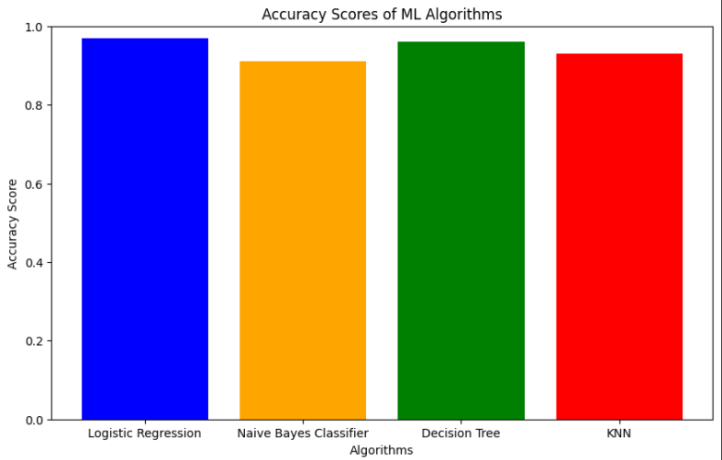
Model Analysis:

Slide 9
Conclusion:
In-depth exploration of hate speech and offensive language detection on Twitter.
Successfully managed challenges through rigorous analysis.
Utilized diverse machine learning models (Decision Tree, KNN, Naive Bayes, Logistic Regression) for effective detection.
Highlighted practical applicability, with KNN identifying inappropriate words in real-world scenarios.
More than an academic endeavor - a dedication to advancing offensive language detection.
Significant contribution to academic discourse and practical content moderation.
Commitment to ongoing research for viable and effective approaches.

Slide 10
Future Works:
The immediate research focus encompasses the refinement and implementation of real-time tweet classification techniques, addressing the dynamic nature of social media discourse.
The next phase involves extending the algorithmic framework to encompass the categorization of diverse textual formats beyond the realm of hate speech, recognizing the evolving linguistic landscape.
Future work will delve into ethical considerations surrounding content filtering, emphasizing the responsible deployment of artificial intelligence in digital communication platforms.
Ongoing research will explore alternative classification algorithms, embracing advancements in the field to enhance the precision and robustness of offensive language detection systems.

Slide 11
Thank You

